Slide 1
Enhancing Support for Children's Homes
This presentation explores a data-driven approach to address limited visibility of children’s homes

Slide 2
Problem Statement
Children's homes in remote areas struggle with low visibility and ineffective fundraising due to a lack of centralized exposure and scattered information, leading to reduced donations and volunteer support.
Understanding the Problem
Lack of public awareness
Inadequate funding sources
Difficulty attracting volunteers
Limited visibility of children's homes reduces donation opportunities.
Reliance on limited funding sources constrains support for children's homes.
Low public exposure hinders volunteer engagement for children's homes.

Slide 3

Problem Significance
Many childrens’ homes in rural or underprivileged areas are not well known, which limits the donations and volunteer support they receive.
People willing to help are often unaware of these homes or upcoming charity events they could support.
Ripple Effect
Low funding leads to reduced care for children, missed opportunities for community involvement, and weakened support systems.

Slide 4

Aligining with SDG 1 No Poverty
Reduce child poverty
Provide financial assistance and social services to support children's homes.
Improve access to basic necessities
Ensure children's homes have adequate food, water, and shelter.
Promote economic empowerment
Offer vocational training and job placement for caregivers and older children.

Slide 5
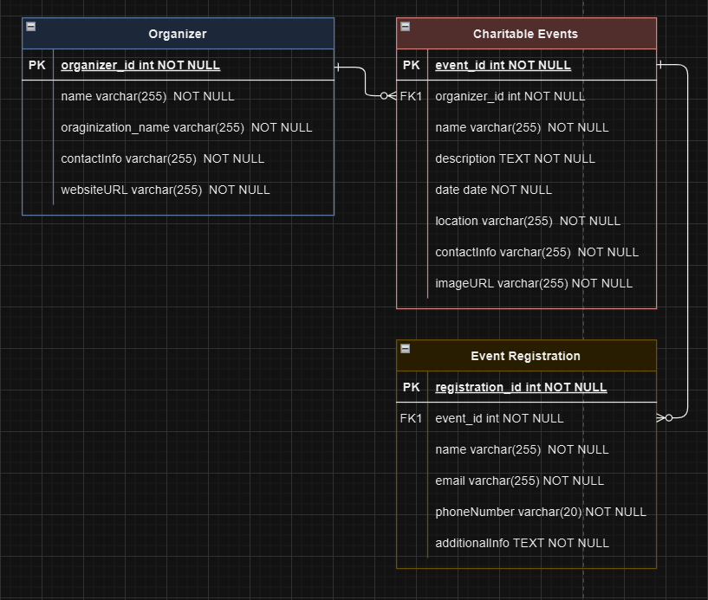
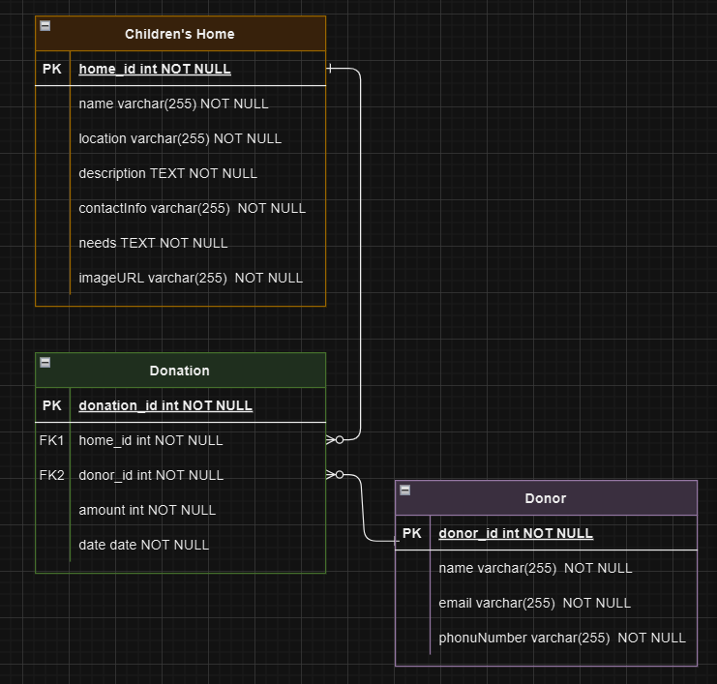
Database Design and Schema Overiew
Entities Identified
Children’s Home
Donor/Volunteer
Charitable Event
Event Registration
Donation
Purpose
To organize and store data related to children’s homes, donors, charitable events, and donations.
Relational Structure
Ensures proper linking between entities like events and donations.
Designed to capture relevant data and make it available for analysis.

Slide 6
Data Analysis Insight
01
Homes in rural areas receive fewer donations compared to those in cities, indicating the need for increased visibility and support for rural homes.
02
Charitable events held in cities receive higher attendance and donations.
03
Many people actively search for children’s homes to visit and support but struggle to find homes, especially those in remote or less-known areas.
04
Homes in rural areas lack visibility, and donors are more likely to donate to homes that are easily accessible or well-promoted.

Slide 7
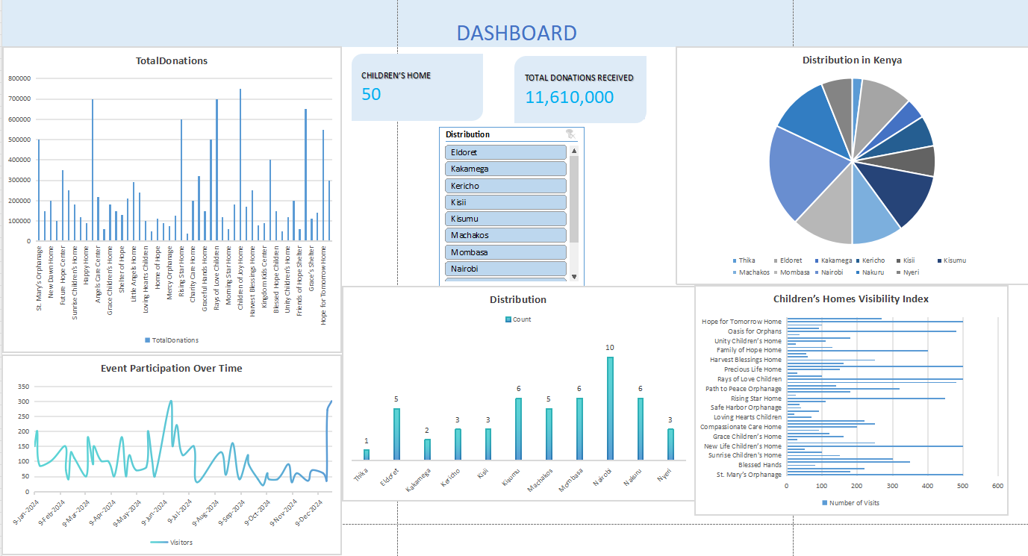
Excel Dashboard

Slide 8

Proposed Solutions
01
Increased Visibility
Use the platform to feature underfunded and remote children’s homes, making them more visible to potential donors.
02
Enhanced Search Functionality
Implement a robust search tool to help people easily find children’s homes, especially in rural or remote areas.
03
Donation Tracking
Provide real-time tracking of donations to increase transparency and encourage continued support.

Slide 9
User Benefit
For Donors: Easily discover homes and events that need support, particularly in underfunded rural areas, with transparent donation tracking.
For Children’s Homes: Gain visibility and increase donations, especially for homes in remote or less-known locations.
For Event Organizers: Reach a broader audience for charitable events, improving engagement and attendance.
For Volunteers: Find meaningful opportunities to give back by locating children’s homes and events in need of on-site support.

Slide 10
Conclusion
Outcome
By making these homes more visible, the platform connects donors and volunteers with those in need, leading to increased donations and community engagement. This results in better care for children, more successful events, and a more connected and supportive community ecosystem.
Next Steps
Continue promoting the platform for broader use.
Use insights from the dashboard to target marketing efforts and fundraising initiatives.
Refine the system based on user feedback and engagement metrics.

